Slide 1

Learner Name | : | Kanimozhi Mani
Course Name | : | Business Analytics and Digital Marketing (BADM)
Batch | : | MBE10
Capstone Title | : | Crafting Compelling Web Presences
Selected Website | : | www.gofrugal.com
About the website selection:
I have selected GoFrugal company’s website for this project.
This is one of the rapidly growing companies with various types of products’ portfolio, where it is in the stage of optimizing its online presence to reaching more audience, improving search engine rankings, and trying to stay top in a competitive market.

Slide 2

TASK 1
Company (Brief Description)
GoFrugal is a digital-first technology company that provides software solutions for businesses, mainly in retail, restaurant, and distribution sectors. Their products help businesses simplify tasks like managing inventory, billing and finances, making operations smoother, improving customer service and supporting business growth.

Slide 3

GLOBAL PRESENCE:
Serving 75+ countries, in 70+ industries providing products and reliable solutions to empowers businesses.
Some of the key industries that GoFrugal is working across are,
SERVICES:
GoFrugal offers a range of services to meet the needs of retail, restaurant, and distribution businesses.
Point of Sale (POS) Solutions
Cloud ERP Solutions
Inventory Management
Supply Chain Management
Customer Relationship Management (CRM)
eCommerce Integration
Mobile Solutions
Accounting and Financial Management
Reporting and Analytics
Consultation and Support
Retail | Pharmacies
Restaurants | Healthcare
Distribution | Manufacturing
E-Commerce | Textiles and Apparel
Founded in 2004
Targets small and medium-sized businesses

Slide 4

TASK 2
Product and Service Descriptions
From absolute POS systems to e-commerce integration, GoFrugal's innovative suite of products and services empowers businesses with efficiency and growth.

Slide 5
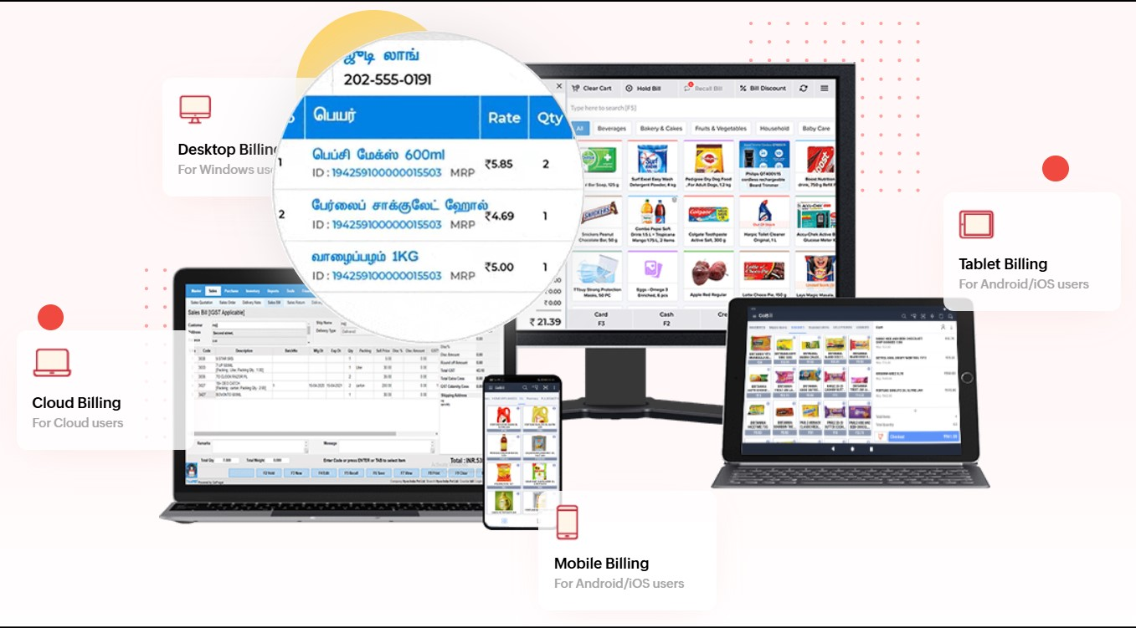
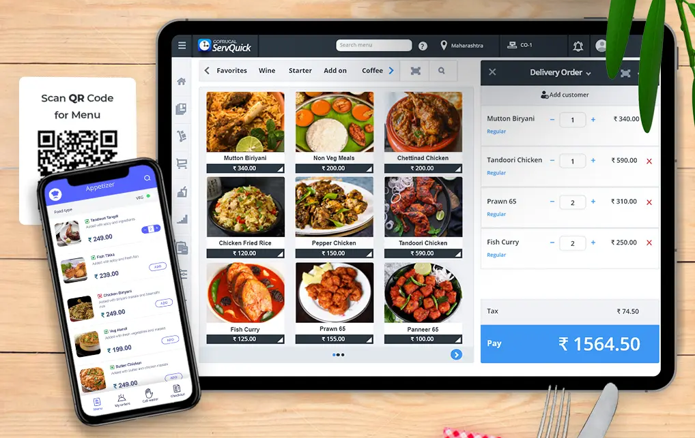
Restaurant POS:
Simplify restaurant management with tools for real-time menu updates, customizable billing, and delivery app integration. Boost efficiency with recipe cost analysis and wastage management.
Retail POS (Point of Sale):
Streamline retail operations with Gofrugal’s POS, offering automated billing, inventory tracking, and real-time business insights. Supports multi-store management and integrates seamlessly with payment gateways.

Slide 6
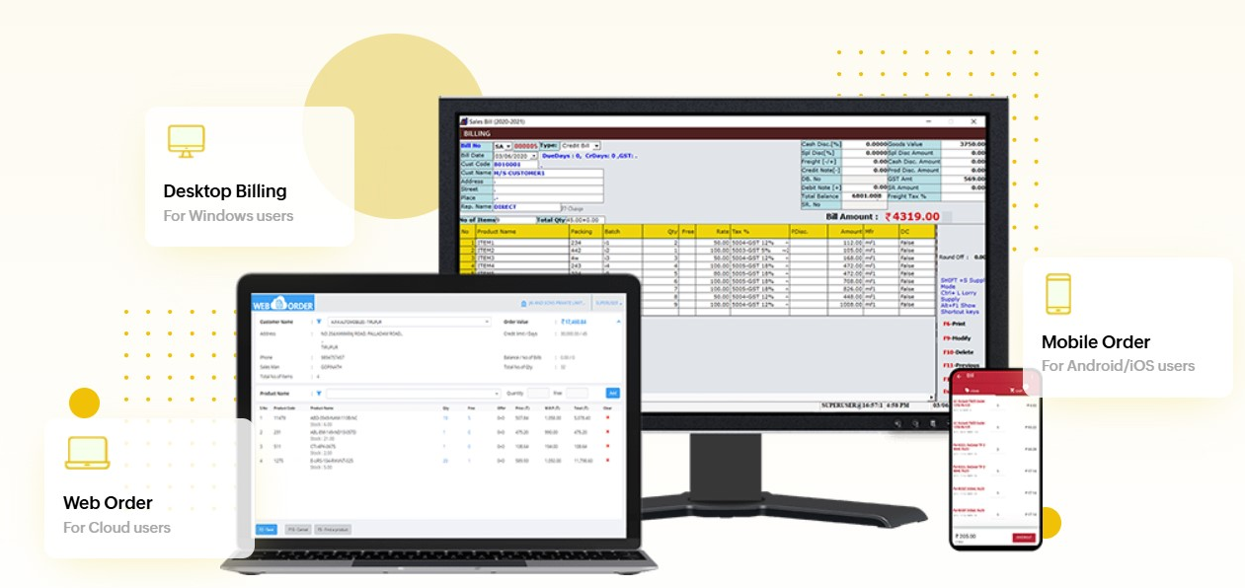
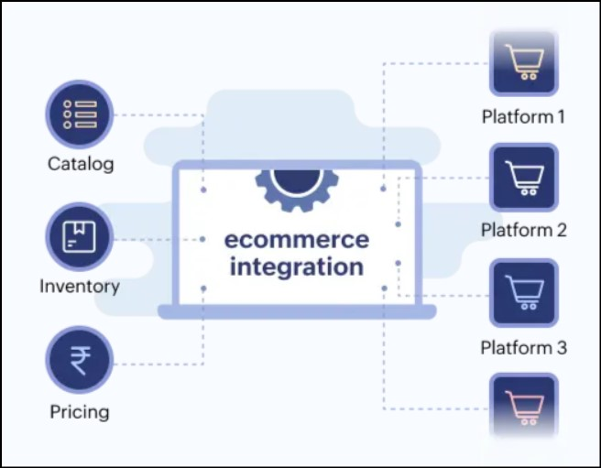
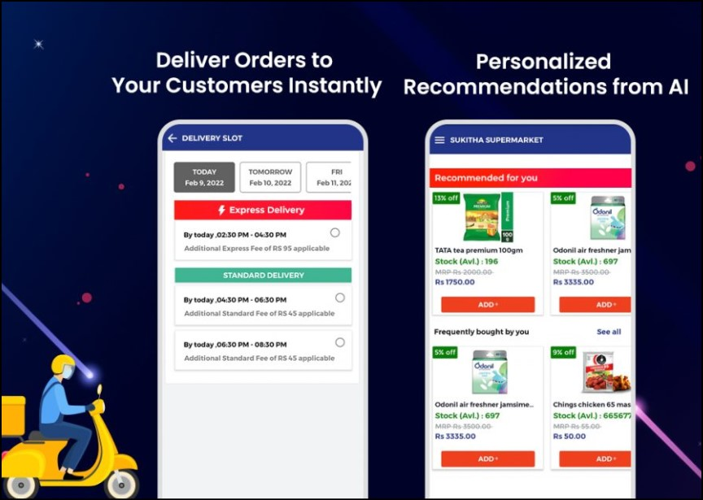
Distribution Management System:
Automate supply chain processes with features for multi-warehouse management, real-time inventory tracking, and auto-replenishment requests based on stock levels.
E-commerce Integration:
Merge physical and online stores effortlessly. Sync inventory and orders across channels, integrate with Shopify and WooCommerce, and deliver a seamless omnichannel experience.
OrderEasy Mobile App:
Offer personalized customer experiences with this mobile app for placing orders, tracking deliveries, and making payments. Designed for enhanced engagement in a digital-first world.

Slide 7

TASK 3
Website Platform Identification
We have identified the platform behind GoFrugal's dynamic website, analyzed using online tools to identify its development framework and technical foundation.

Slide 8
Content Management System (CMS)
WordPress 4.8.4: Gofrugal uses WordPress as the CMS (Content Management System) to manage and organize their website content. The version in use is WordPress 4.8.4, (which is released in the year 2017) which is slightly outdated, indicating it may need an update for better security and performance.
Theme: Oblique Theme
Plugins: The website uses the following plugins to enhance functionality:
Jetpack
Disqus
Email Subscribers
Featured Video Plus
Contextual Related Posts
Custom Share Buttons with Floating Sidebar
Web Framework
Bootstrap: Bootstrap, a popular front-end framework, is used for designing responsive and mobile-friendly web pages. This ensures that the site looks good on all devices.
Web Server
Apache 2.4.6: The website is hosted on an Apache 2.4.6 web server, a widely used and reliable option for website hosting.

Slide 9
Programming Language
PHP 5.3.3: PHP is used for server-side scripting. The website is running on PHP version 5.3.3, which is quite old, and updating to a more recent version would improve both performance and security.
Dev Tools
HTML5 Shiv: A script used to support HTML5 elements in older browsers, ensuring compatibility.
Analytics
Google Analytics UA: Gofrugal uses Google Analytics UA (Universal Analytics) to track user activity and gather insights into website traffic, user behaviour, and performance metrics.
Font Script
Google Font API: The website uses Google Font API to ensure consistent font compatible across different browsers and devices.
Editors
DreamWeaver: The website is developed or edited using Adobe Dreamweaver, a popular website development tool.

Slide 10
Recommendations:
Update PHP Version: The current PHP version (5.3.3) is outdated. Upgrading to a more recent version will provide security improvements and performance enhancements.
Update WordPress Version: WordPress 4.8.4 is not the latest version. An update would provide better security and new features.
Mobile Optimization: The site uses Bootstrap for responsive design, but it would be good to ensure testing across all devices for a seamless experience.
This comprehensive overview highlights the key technologies Gofrugal is utilizing to manage and enhance their website’s functionality.

Slide 11
TASK 4
Responsive Design Testing
We have evaluated GoFrugal's website for responsive design and mobile optimization using online tools. This detailed report highlights performance across five key pages.
Pages Tested:
Homepage
Products Page
Contact Page
Blog Page
Downloads Page

Slide 12
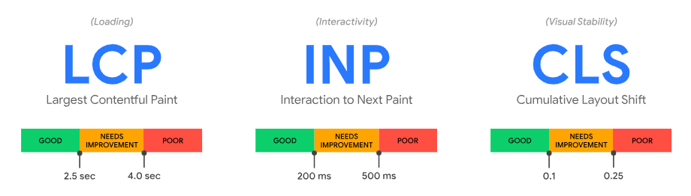
Terms Used
Largest Contentful Paint (LCP): LCP is a web performance metric that measures how long it takes for the largest content on a web page to be visible to a user.
Interaction to Next Paint (INP): INP is a web performance metric that measures user interface responsiveness – how quickly a website responds to user interactions like clicks or key presses.
Cumulative Layout Shift (CLS): CLS measures the unexpected shifting of web elements while the page is being rendered. This measurement is then quantified as an aggregate score of all the individual layout shifts on your page.

Slide 13
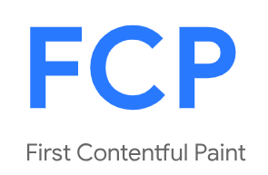
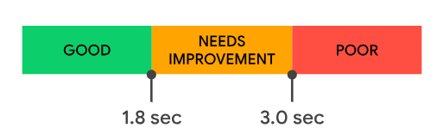
Speed Index
1.3 sec
1.7 sec
First Contentful Paint (FCP): FCP measures how long it takes for content to start appearing on a website.
Speed Index (SI): SI is a metric that measures how quickly a web page's content is visually displayed during the loading process.

Slide 14
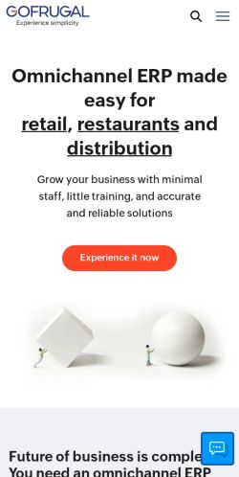

Page 1: Home Page https://www.gofrugal.com/ Device: Mobile
Largest Contentful Paint (LCP):
Status: Pass
Time taken: 2.3s
Interaction to Next Paint (INP):
Status: Pass
Time taken: 2.3s
Cumulative Layout Shift (CLS):
Status: Pass
Score: 0.054
First Contentful Paint (FCP):
Status: Fail
Time taken: 2.3s
Speed Index (SI):
Status: Pass
Time taken: 0.8s
Recommendations:
Optimize images: Reduce the size of images without affecting quality.
Eliminate render-blocking resources: JavaScript and CSS are common render-blocking resources that can slow down loading speed.

Slide 15
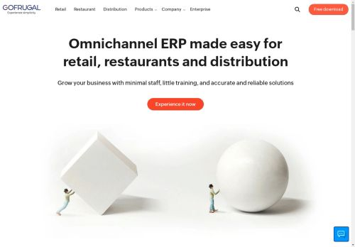
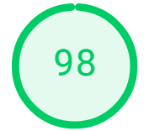
Page 1: Home Page https://www.gofrugal.com/ Device: Desktop
Largest Contentful Paint (LCP):
Status: Pass
Time taken: 0.9s
Interaction to Next Paint (INP):
Status: Pass
Time taken: 51ms
Cumulative Layout Shift (CLS):
Status: Pass
Score: 0.054
First Contentful Paint (FCP):
Status: Pass
Time taken: 0.5s
Speed Index (SI):
Status: Pass
Time taken: 0.9s

Slide 16
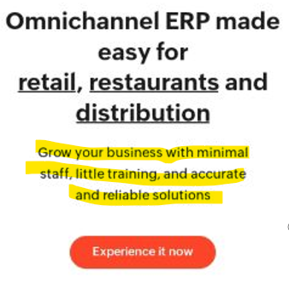
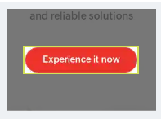
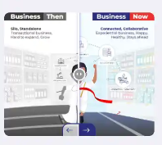
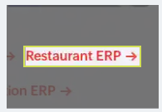
Page 1: Home Page https://www.gofrugal.com/
Navigation: Heading elements are not in a sequentially-descending order.
STRENGTHS:
Efficiently encoded images
Multiple page redirects are avoided
AREAS TO IMPROVEMENT: Accessibility Issues
Names and Labels: Buttons do not have an accessible name. When a button doesn't have an accessible name, screen readers announce it as "button", making it unusable for users who rely on screen readers.
Form elements do not have associated labels. Labels ensure that form controls are announced properly by assistive technologies, like screen readers.
Links do not have a noticeable name. Link text is the text you select for a link that describing what happens when a user activates it.
Contrast: Background and foreground colors do not have a sufficient contrast ratio. Low-contrast text is difficult or impossible for many users to read.

Slide 17
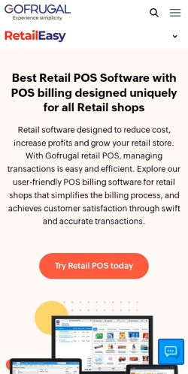
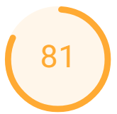
Page 2: Products Page https://www.gofrugal.com/retail/
Device: Mobile
Largest Contentful Paint (LCP):
Status: Fail
Time taken: 3.9s
Interaction to Next Paint (INP):
Status: Pass
Time taken: 102ms
Cumulative Layout Shift (CLS):
Status: Pass
Score: 0.067
First Contentful Paint (FCP):
Status: Fail
Time taken: 4.3s
Speed Index (SI):
Status: Pass
Time taken: 3.0s
Recommendations:
Optimize images: Reduce the size of images without affecting quality.
Eliminate render-blocking resources: JavaScript and CSS are common render-blocking resources that can slow down loading speed.

Slide 18
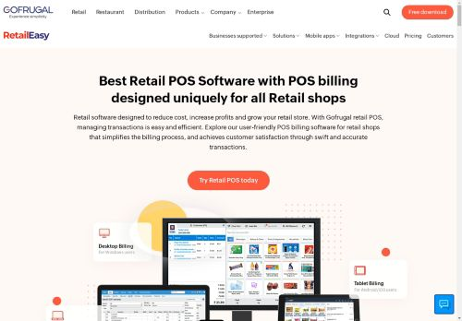
Page 2: Products Page https://www.gofrugal.com/retail/
Device: DeskTop
Largest Contentful Paint (LCP):
Status: Pass
Time taken: 1.0s
Interaction to Next Paint (INP):
Status: Pass
Time taken: 55ms
Cumulative Layout Shift (CLS):
Status: Pass
Score: 0.054
First Contentful Paint (FCP):
Status: Pass
Time taken: 0.6s
Speed Index (SI):
Status: Pass
Time taken: 1.2s

Slide 19
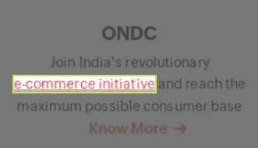
Page 2: Products Page https://www.gofrugal.com/retail/
STRENGTHS:
All text remains visible during webfont loads
Image elements have explicit width and height
AREAS TO IMPROVEMENT: Accessibility Issues
Names and Labels: <frame> or <iframe> elements do not have a title. Screen reader users rely on frame titles to describe the contents of frames.
Links do not have a noticeable name. Link text is the text you select for a link that describing what happens when a user activates it.
Avoid an excessive DOM size as a large DOM will increase memory usage.
Contrast: Background and foreground colors do not have a sufficient contrast ratio. Low-contrast text is difficult or impossible for many users to read.

Slide 20
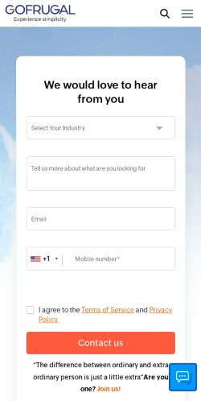
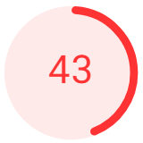
Page 3: Contacts Page https://www.gofrugal.com/contact.html
Device: Mobile
Largest Contentful Paint (LCP):
Status: Fail
Time taken: 10.1s
Interaction to Next Paint (INP):
Status: Pass
Time taken: 156ms
Cumulative Layout Shift (CLS):
Status: Pass
Score: 0.067
First Contentful Paint (FCP):
Status: Fail
Time taken: 4.5s
Speed Index (SI):
Status: Fail
Time taken: 2.3s
Recommendations:
Optimize images: Reduce the size of images without affecting quality.
Eliminate render-blocking resources: JavaScript and CSS are common render-blocking resources that can slow down loading speed.

Slide 21
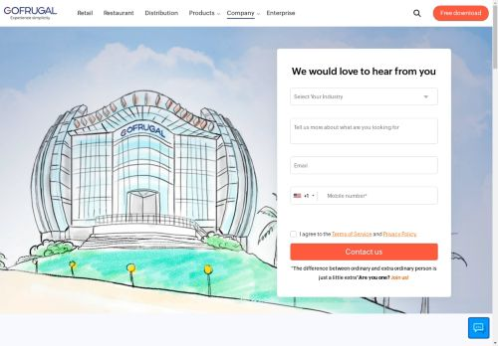

Page 3: Contacts Page https://www.gofrugal.com/contact.html
Device: DeskTop
Largest Contentful Paint (LCP):
Status: Fail
Time taken: 2.3s
Interaction to Next Paint (INP):
Status: Pass
Time taken: 63ms
Cumulative Layout Shift (CLS):
Status: Pass
Score: 0.054
First Contentful Paint (FCP):
Status: Pass
Time taken: 0.6s
Speed Index (SI):
Status: Pass
Time taken: 1.7s

Slide 22
Page 3: Contacts Page https://www.gofrugal.com/contact.html
STRENGTHS:
All text remains visible during webfont loads
Image elements have explicit width and height
AREAS TO IMPROVEMENT: Accessibility Issues
Names and Labels: <frame> or <iframe> elements do not have a title. Screen reader users rely on frame titles to describe the contents of frames.
Form elements do not have associated labels.
Reduce unused CSS
Preload Largest Contentful Paint image
Does not use passive listeners to improve scrolling performance
Avoid an excessive DOM size as a large DOM will increase memory usage.

Slide 23
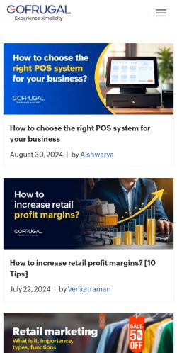
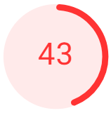
Page 4: Blog Page https://www.gofrugal.com/blog/
Device: Mobile
Largest Contentful Paint (LCP):
Status: Fail
Time taken: 4.6s
Interaction to Next Paint (INP):
Status: Pass
Time taken: 120ms
Cumulative Layout Shift (CLS):
Status: Fail
Score: 0.412
First Contentful Paint (FCP):
Status: Fail
Time taken: 2.4s
Speed Index (SI):
Status: Fail
Time taken: 1.7s
Recommendations:
Optimize images: Reduce the size of images without affecting quality.
Eliminate render-blocking resources: JavaScript and CSS are common render-blocking resources that can slow down loading speed.

Slide 24
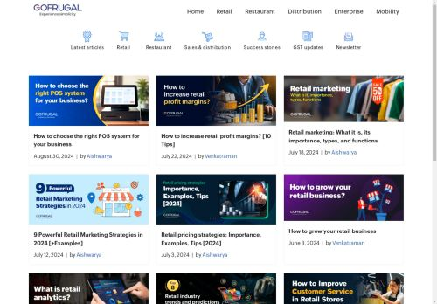
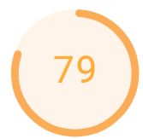
Page 4: Blog Page https://www.gofrugal.com/blog/
Device: Desktop
Largest Contentful Paint (LCP):
Status: Fail
Time taken: 1.2s
Interaction to Next Paint (INP):
Status: Pass
Time taken: 60ms
Cumulative Layout Shift (CLS):
Status: Fail
Score: 0.354
First Contentful Paint (FCP):
Status: Pass
Time taken: 0.8s
Speed Index (SI):
Status: Pass
Time taken: 1.3s

Slide 25
Page 4: Blog Page https://www.gofrugal.com/blog/
Device: Desktop
Largest Contentful Paint (LCP):
Status: Fail
Time taken: 1.2s
Interaction to Next Paint (INP):
Status: Pass
Time taken: 60ms
Cumulative Layout Shift (CLS):
Status: Fail
Score: 0.354
First Contentful Paint (FCP):
Status: Pass
Time taken: 0.8s
Speed Index (SI):
Status: Pass
Time taken: 1.3s

Slide 26
Page 4: Blog Page https://www.gofrugal.com/blog/
STRENGTHS:
All text remains visible during webfont loads
Uses HTTPS
Displays images with correct aspect ratio
Allows users to paste into input fields. Preventing input pasting is a bad practice for the UX, and weakens security by blocking password managers.
Avoids requesting the geolocation permission on page load
AREAS TO IMPROVEMENT: Accessibility Issues
Avoid large layout shifts
Largest Contentful Paint image was lazily loaded
Properly size images
Image elements do not have explicit width and height
Uses third-party cookies 1 cookie found
Serves images with low resolution

Slide 27
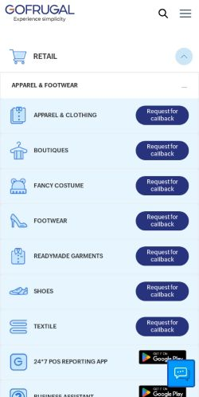
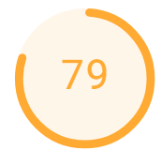
Page 5: Downloads Page https://www.gofrugal.com/downloads.html
Device: Mobile
Largest Contentful Paint (LCP):
Status: Fail
Time taken: 4.9s
Interaction to Next Paint (INP):
Status: NA
Cumulative Layout Shift (CLS):
Status: Pass
Score: 0.067
First Contentful Paint (FCP):
Status: Fail
Time taken: 2.2s
Speed Index (SI):
Status: Pass
Time taken: 2.5s
Status: NA
(If you're testing a static page with limited user engagement, pagespeed might not track these metrics as they wouldn't be representative of your website's overall user experience.)

Slide 28
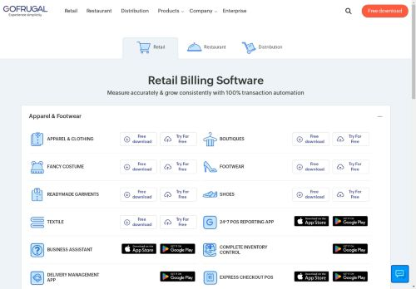
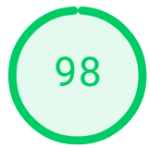
Page 5: Downloads Page https://www.gofrugal.com/downloads.html
Device: Desktop
Largest Contentful Paint (LCP):
Status: Pass
Time taken: 0.9s
Interaction to Next Paint (INP):
Status: Pass
Time taken: 24ms
Cumulative Layout Shift (CLS):
Status: Pass
Score: 0.054
First Contentful Paint (FCP):
Status: Pass
Time taken: 0.5s
Speed Index (SI):
Status: Pass
Time taken: 1.1s

Slide 29
Page 5: Downloads Page https://www.gofrugal.com/downloads.html
STRENGTHS:
Page has the HTML doctype
Uses HTTPS
Allows users to paste into input fields
Properly defines charset
Touch targets have sufficient size and spacing.
Input buttons have discernible text.
AREAS TO IMPROVEMENT: Accessibility Issues
Uses third-party cookies - 1 cookie found
<frame> or <iframe> elements do not have a title
Reduce unused JavaScript
Avoid an excessive DOM size

Slide 30
TASK 5
Website Mistakes Identification
Analyzed GoFrugal's website to identify design pitfalls like cluttered layouts and slow loading times.
Provided actionable suggestions to enhance user experience and performance.

Slide 31
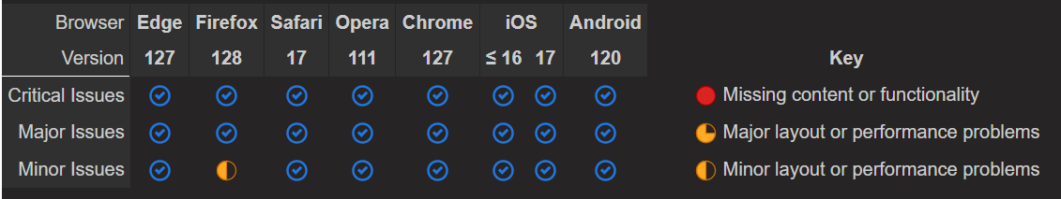
Analysis:
Broken links - Some pages contain links that don't work.
HTML form control has no accessible name.
A label linked to the control allows the screen readers to voice the label correctly when reading the control.
Links must have an accessible name.
A link name allows screen readers to voice what the links does. If there is no link content, or the link content is hidden by CSS, screen readers have nothing to read. Also, generic link labels like ‘Click here’ or ‘ Read more’ doesnt explains any link purpose.
Change the link text so the link makes sense when screen readers access it.
Ensure that text and background colours have enough contrast.
Some users find it hard to read light grey text on a white background, dark grey text on a black background and white text on a red background.
Suggestions:
Radio buttons are easier to use than drop-downs when there are 6 choices or fewer.
Use at least a 12-point font on all web pages for better readability.
This below table shows pages that exhibit browser-specific behaviour.

Slide 32
TASK 6
Best Practices List for Website creation
Compiled a comprehensive list of best practices to craft visually appealing and user-friendly website designs. Focuses on enhancing aesthetics, usability, and overall user experience.

Slide 33
Best Practices for creating visually appealing and user-friendly Web designs:
Responsive Design: Ensure the site works well on all devices, including mobile and desktop.
Simple Navigation: Use an intuitive menu to help users find what they need quickly.
Fast Loading: Optimize images and reduce heavy code for faster page speeds.
Clear CTAs: Place prominent and compelling call-to-action buttons like "Sign Up" or "Get Started."
Consistent Branding: Maintain uniform colors, fonts and logos to reflect your brand identity.
SEO Optimization: Use proper headings, metadata, and a logical structure to improve visibility.
Accessibility: Include alt-text for images, readable fonts, and keyboard-friendly navigation.

Slide 34
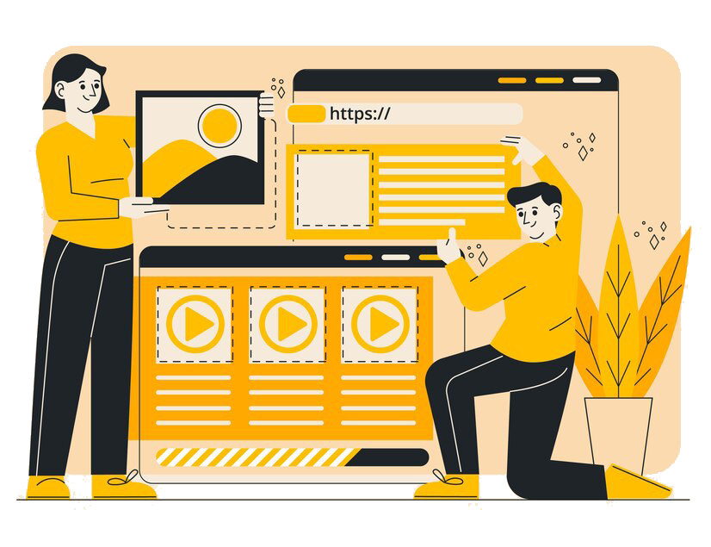
TASK 7
Landing Page Design
I have created and designed a home page for GoFrugal website using Wix software with an imaginary product called “On CUE," inspired by Gofrugal’s real product called “ServQuick”.
The design highlights the product's features, aims to increase brand awareness, and encourages potential customers to take action, such as exploring more or getting in touch.
Please Ctrl + Click the below link:
https://kanimozhims05.wixsite.com/gofrugal-3

Slide 35

Thanks for
your attention.!
"A great website doesn’t just build traffic; it builds trust." – Anonymous

